Slide 1
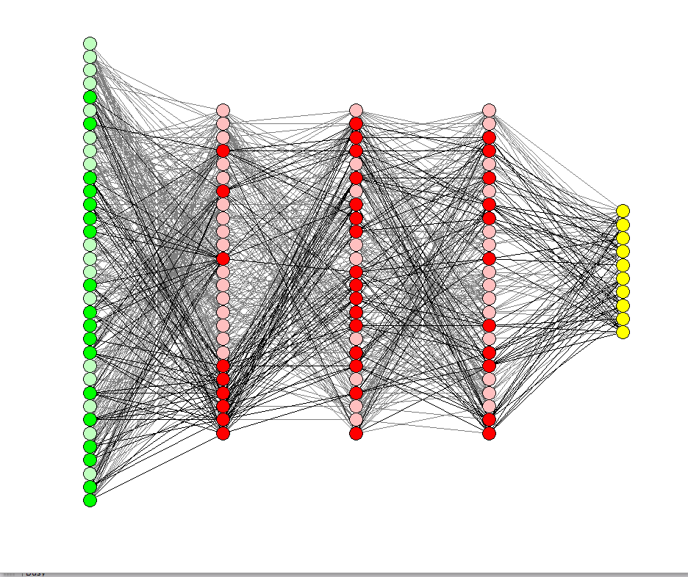
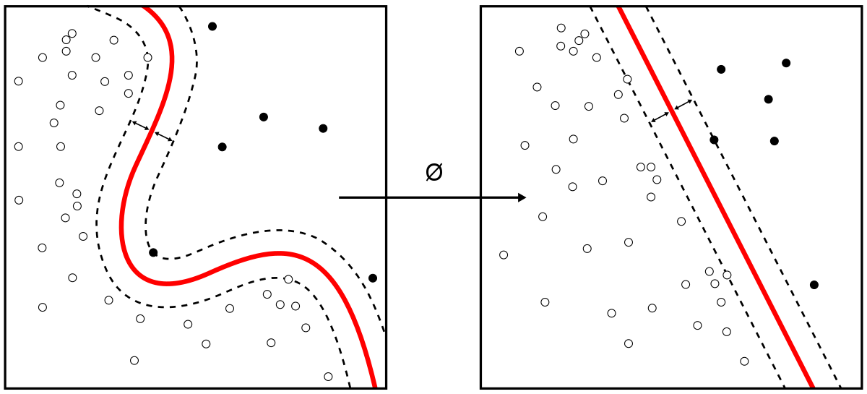
US CENSUS INCOME PREDICTION (1994 – 1995)
Group Members:
Aditya Agrawal
Mina Kazemi
Shubham Patidar

Slide 2

PROBLEM STATEMENT
The dataset is for US Census income from the year 1994 - 1995. It includes details about the person such as age, sex, place, education, type of employment, minimum age, and so on. Most of the Data is either categorical or numerical.
We are given a dataset consisting of information about people's income. Our goal is to predict whether the income of a person is more than $50k, or less than $50k per year based on the given attributes.
Our dataset consists of 2,99,285 instances and 42 attributes or features with 29 categorical features and 13 numeric features.

Slide 3
Under sampling
Method
Data Manipulation and Feature Engineering
SMOTE Method
Oversampling Method
Data Sampling
Logistic Regression
Naïve Bayes
Data Exploration and Data Cleaning
Exploratory Data Analysis
Principal Component Analysis
SVM

Slide 4
DATA EXPLORATION AND DATA CLEANING
To ensure that the data is cleaned and does not have inconsistent data, we have performed the following steps:
Dropped irrelevant columns which had either ”?” or “Not In Universe”.
Checked for outliers
Replacing Categorical values with appropriate values.
Checked for null values

Slide 5
DATA MANIPULATION AND FEATURE ENGINEEING
After cleaning and pre-processing the data, we will manipulate the attributes and perform feature engineering to ensure that the model accuracy is improved.
Check the data distribution for our Numeric attributes and replace irrelevant or missing values with mean.
For categorical variables with 2-3 sub-categories, we have performed Label encoding.
And, for categorical variables with more than 5 sub-categories, we have performed Dummy Encoding.

Slide 6
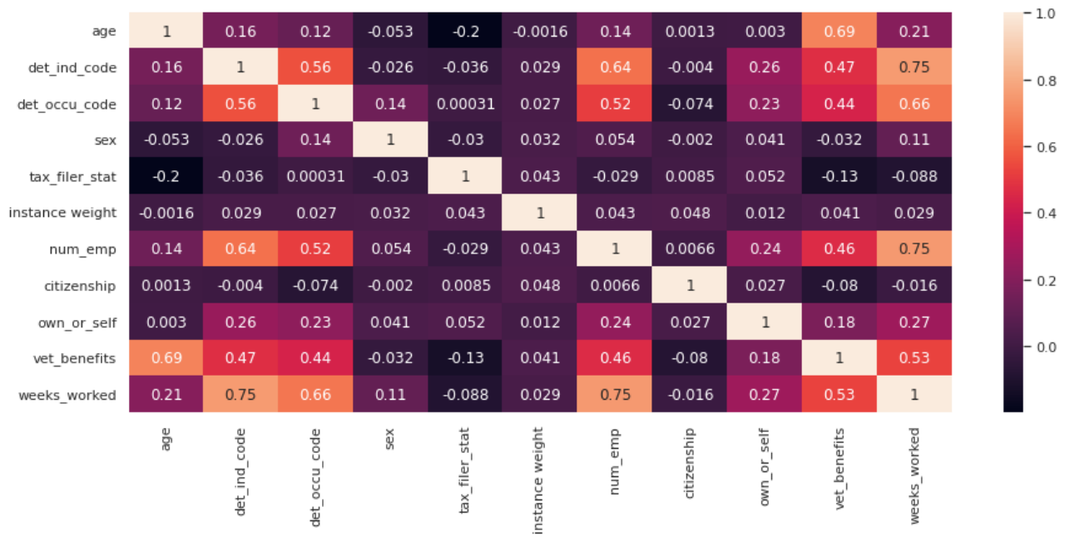
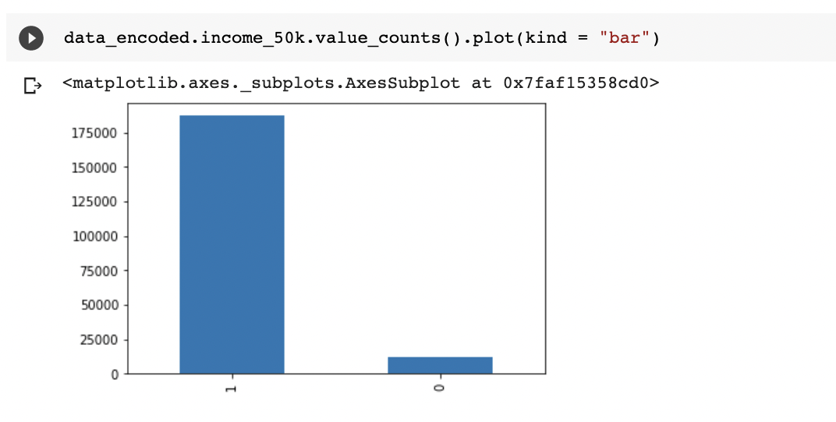
EXPLORATORY DATA ANALYSIS​
First graph provides insight into the co-relation between the features of our dataset. Lighter the color, higher the co-relation between the features.​
We have removed “Weeks_worked” and “Vet_benifts” as it was having high correlation with “Age” and “Num_emp”
In the bar graph we can interpret that for the Target variable, there are around “187141” number of 1’s and “12382” number of 0’s. This shows that the target class is Imbalanced.

Slide 7
MACHINE LEARNING
1. Oversampling
Data Sampling
Since our target variable (income) is imbalanced, we have used Data Sampling Techniques.
Our aim is also to compare the accuracy of the Imbalance data with the Balanced Dataset
CLASS1
CLASS1
CLASS0
CLASS0
=
3. Smote
2. Under sampling
CLASS1
Class 1
CLASS0
Class 1
CLASS0
=
CLASS0
=
CLASS1
CLASS0

Slide 8
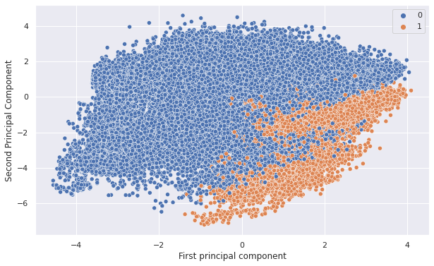
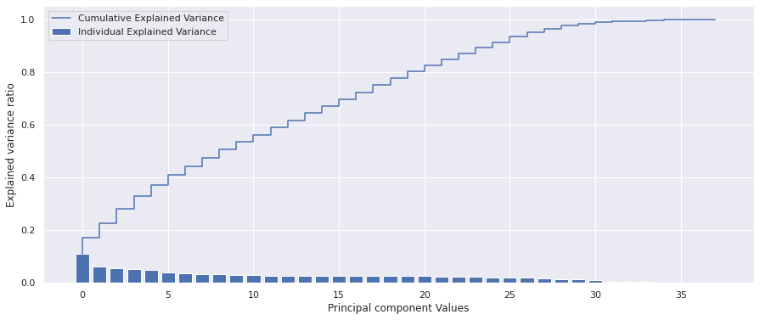
Principal Component Analysis (PCA)
Steps:
Standardize the data using Min-max scalar()
Calculate the covariance of the matrix and compute Eigen values and Eigen Vectors accordingly.
Calculate the variance captured by top N components after sorting the values.

Slide 9
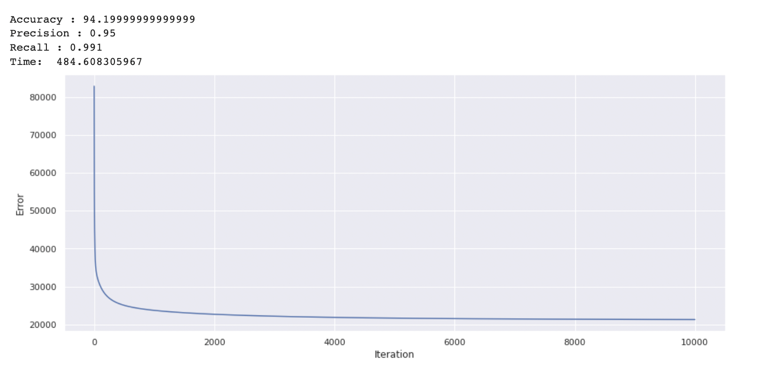
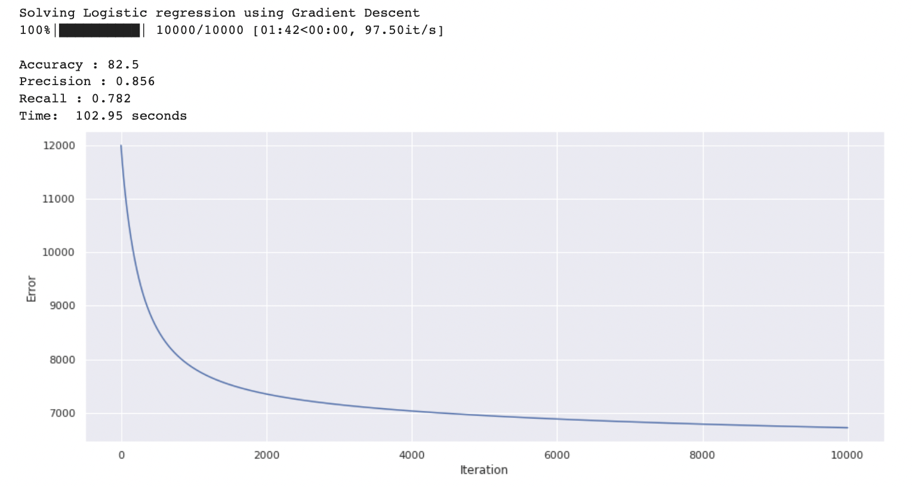
LOGISTIC REGRESSION
Steps:
We split our dataset into training and testing dataset in a ratio of 0.7 : 0.3
Implemented the Sigmoid Function to map the predicted values to probabilities
Used Negative likelihood as our cost function
Compared the original data’s result with the sampled data results
Original dataset
Undersampled Data

Slide 10
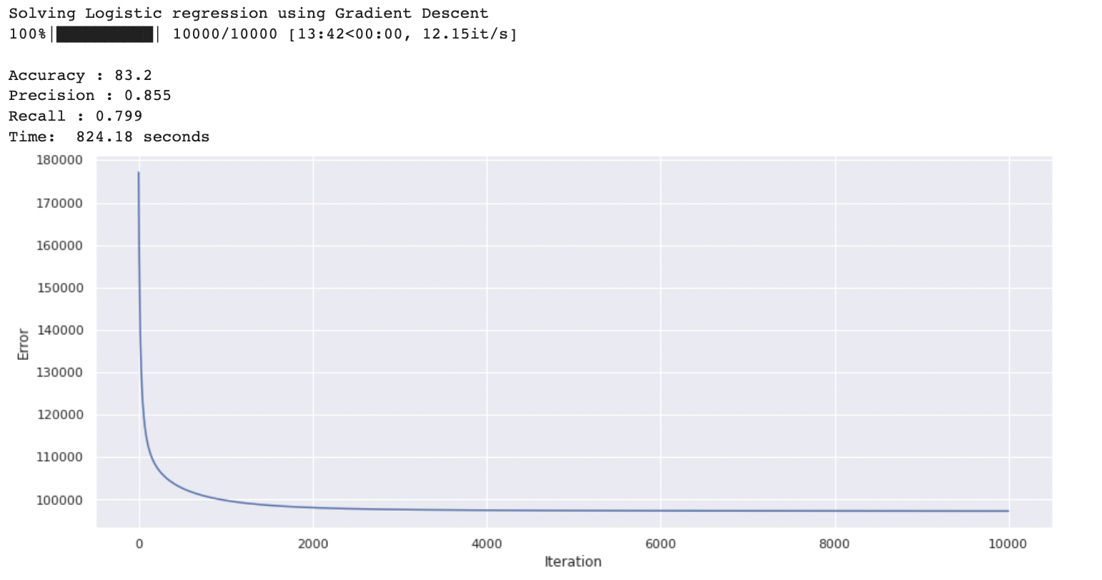
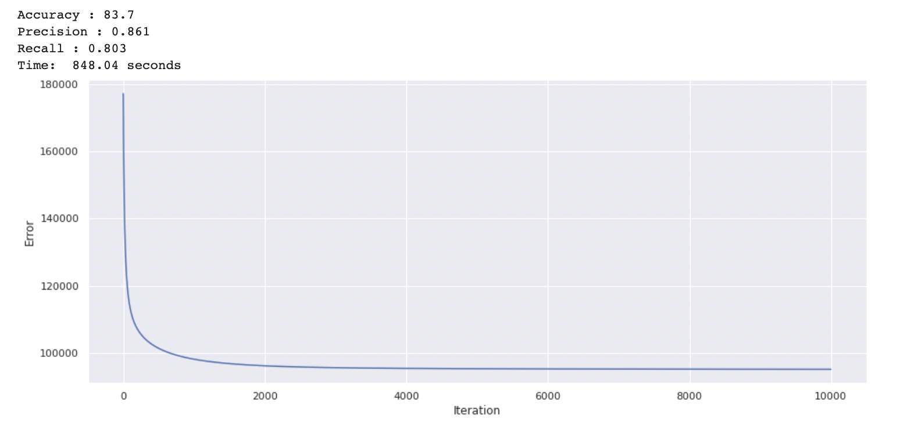
LOGISTIC REGRESSION
Oversampled dataset
SMOTE Data

Slide 11
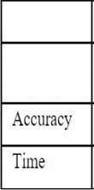
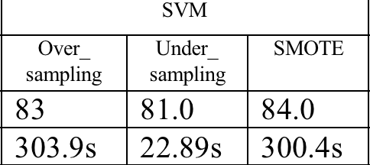
Support Vector Machine
SVM works by mapping data to a high-dimensional feature space so that data points can be categorized, even when the data are not otherwise linearly separable.
We tried to separate class of 1s and 0s using SVM. Two class are divided using decision boundary. Basic idea is to find the maximum margin between closet data points of opposite class to draw decision boundary.
Table shows Model results for all types of sampling.

Slide 12
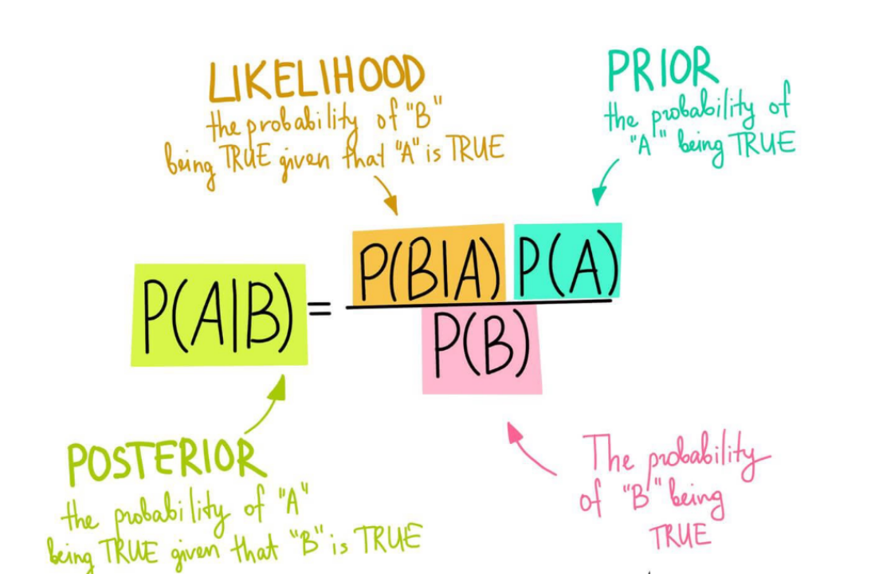
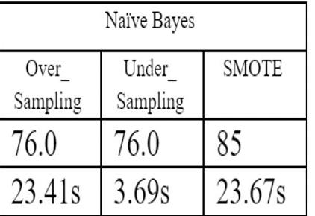
Naïve Bayes
Naive Bayes uses a similar method to predict the probability of different class based on various attributes. This algorithm is mostly used in text classification and with problems having multiple classes

Slide 13
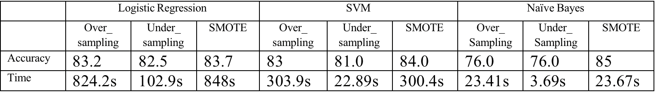
RESULTS
Out of all the models we have compared in our projects. We have compared our models based on time it has taken and accuracy for the given target variable.
Naïve Bayes gives best results using SMOTE sampling method where accuracy is 85% and time taken for model execution is 23.67 seconds.

Slide 14
THANK YOU!!

